Slide 1
Session 0 - A Whole New World

Slide 2
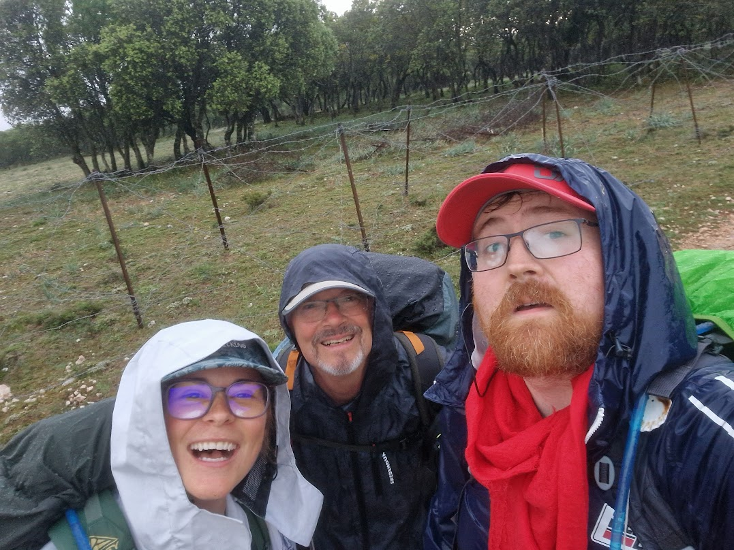
Welcome!
Welcome to the first session of this summer school!
My name is Kev O Malley, and I’m the nerd who’ll be going through this material with you

Slide 3
In this session, we’re going to:
Give you an overview of the course:
What we’re going to be doing (learning together).
Why we’re doing it (to empower each other).
What you can expect to get out of it (a sense of agency and efficacy).
Introduce you to the tools we’re going to be using (and mention some of the alternatives).
Quarto (as a tool for writing documents, reports, and papers).
Python (as a tool for doing data analysis and visualisation).
R (as an alternative to Python for doing data analysis and visualisation).
Git (as a tool for collaboration, managing your documents and code)
Accompany you through the process of producing your first documents using these tools.

Slide 4

But first…
Let’s address the elephant in the room.
When you think of people who work with computer programming, you may think of people that look like this…

Slide 5
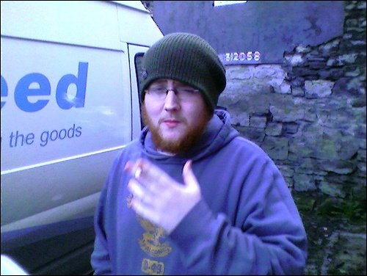
Or maybe like this

Slide 6
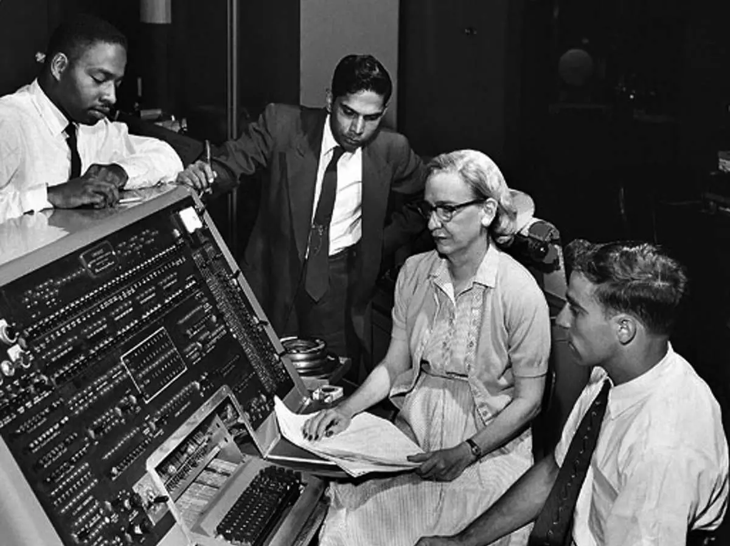
But in reality…
These tools were developed by, and are used by, people from all walks of life
AND ALWAYS HAVE BEEN

Slide 7
So here’s a couple of quotes that inspired these materials
‘The Great Being saith: Regard [humanity] as a mine rich in gems of inestimable value. Education can, alone, cause it to reveal its treasures, and enable mankind to benefit therefrom.’ (Baha’u’llah 19th century)
“We are what we repeatedly do. Excellence, therefore, is not an act, but a habit.” (Durant 1933, paraphrasing Aristotle)

Slide 8
Structure of the course
Lorem ispsum

Slide 9
References
Baha’u’llah. 19th century. “Tablet of Baha’u’llah: Lawh-i-Maqsud.” Manuscript. https://www.bahai.org/library/authoritative-texts/bahaullah/tablets-bahaullah/5#722342929.
Durant, W. 1933. The Story of Philosophy. https://books.google.ie/books?id=IAk7zgEACAAJ.

